Slide 1
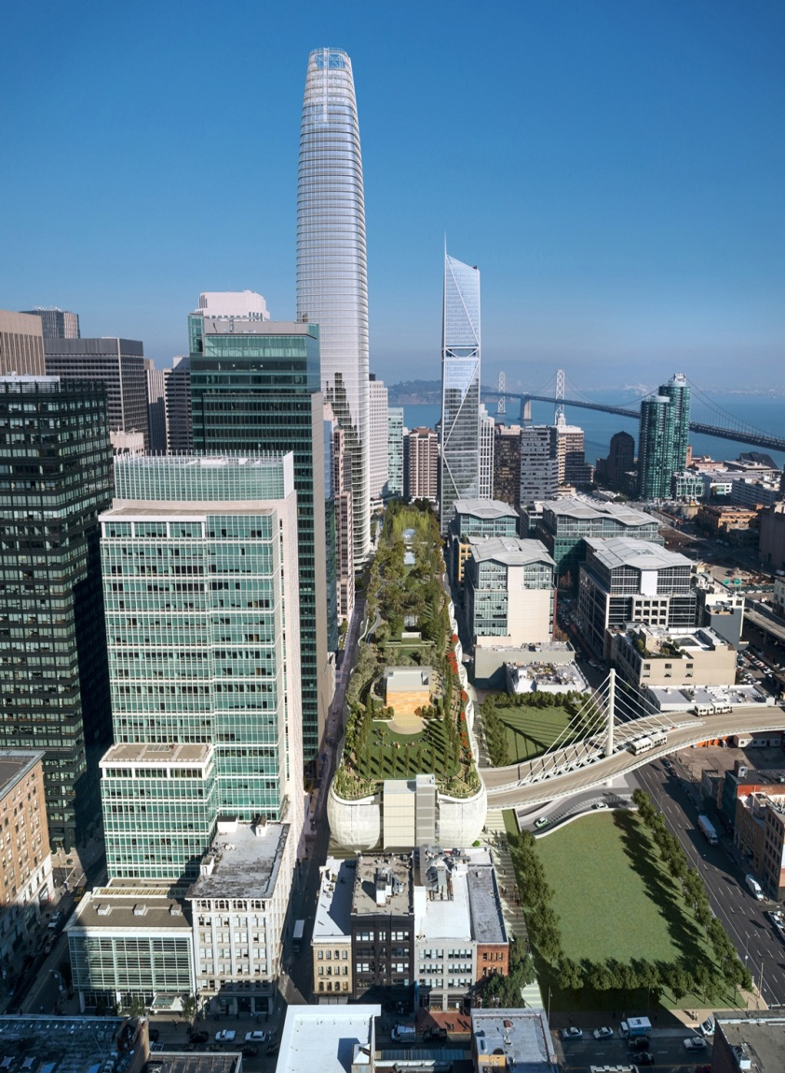
TRANSBAY TRANSIT CENTER
TG16.1 Drywall/Framing
Pre-Bid Question and Answer Session Webcor/Obayashi Joint Venture Office 175 Beale St.
San Francisco, CA
2:00PM October 2, 2014
Please sign in!
Notes:
Welcome!

Slide 2
Transbay Transit Center TG16.1 Drywall/Framing
Project General Information
Client: Transbay Joint Powers Authority (TJPA)
Construction Manager/General Contractor: Webcor/Obayashi Joint Venture
Architect: Pelli Clarke Pelli Architects / Adamson Associates

Slide 3
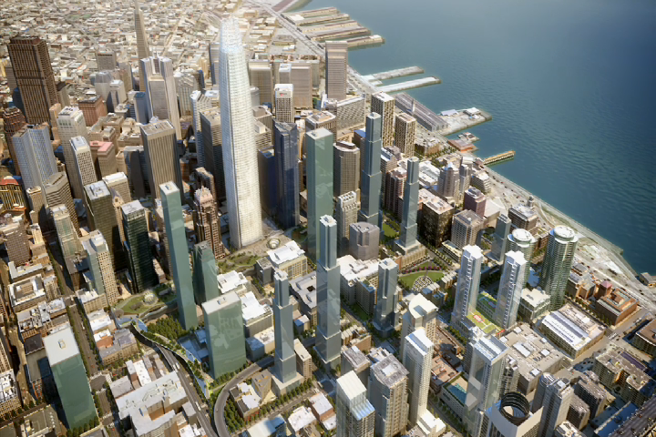
TRANSBAY DISTRICT
Notes:
The Transbay Transit Center will provide a modern, state-of-the-art transit hub for downtown San Francisco. The new facility will draw together modes of public and private transportation, creating a grand entry point to the city in the spirit of the great stations of the world. The new Transit Center has and will spur development in the surrounding city blocks, anchoring the growth of a new residential mixed-use urban neighborhood.

Slide 4
TRANBAY TRANSIT CENTER
Notes:
The Transbay Transit Center will be the focus of a new neighborhood for San Francisco and a destination for retail, art, community events, and cultural activities. The building’s design is highly accessible, sustainable, and attractive, with a 5.4-acre public rooftop park, grand light-filled spaces, and a distinctive metal façade.

Slide 5
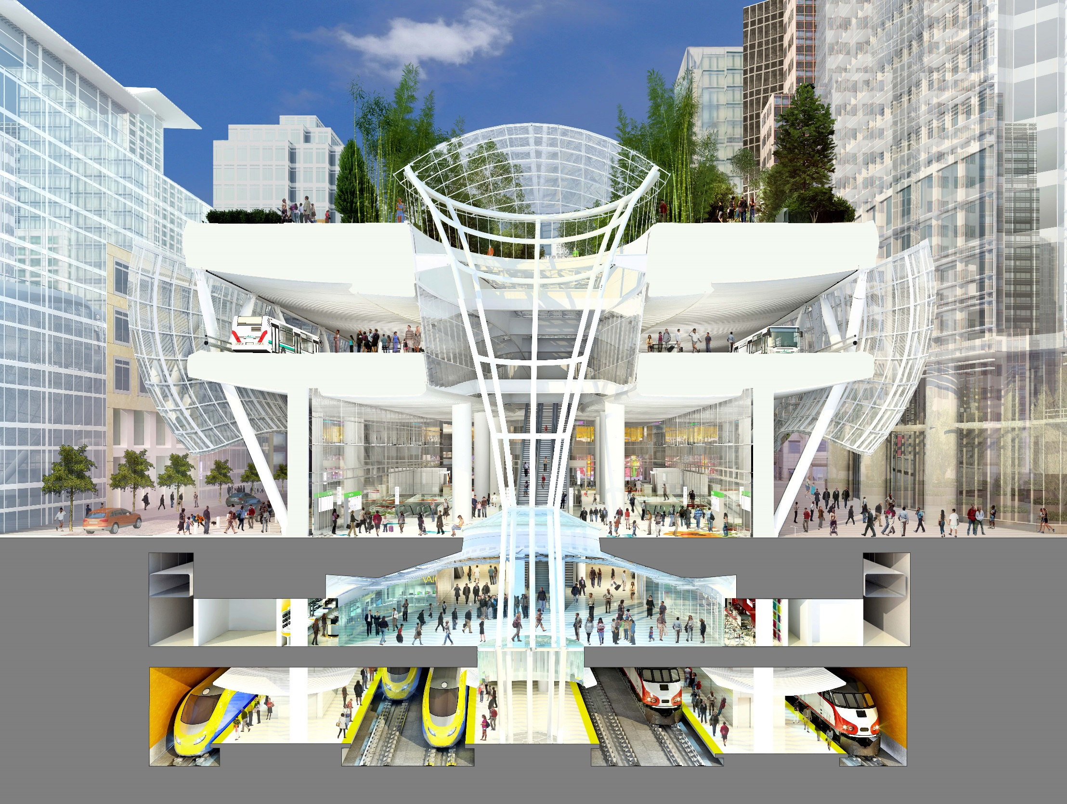
55 ft
PARK LEVEL
BUS DECK LEVEL
120 ft
40 ft
70 ft
35 ft
GRAND HALL
MISSION SQUARE
GROUND LEVEL
RETAIL
PUBLIC CONCOURSE & WAITING AREA
RETAIL
LOWER CONCOURSE LEVEL
CHSR PLATFORM
CHSR PLATFORM
CALTRAIN PLATFORM
TRAIN PLATFORM LEVEL
BUILDING SECTION
Notes:
The building’s design is graceful, luminous, welcoming, and safe. Its undulating metal exterior wall, with forms like the petals of a flower, is shaped to reduce the scale of this very large structure. On the interior, tall, structurally expressive skylights known as Light Columns bring natural light deep into the building as well as help support the upper floors. The largest Light Column forms the public element of the 120-foot tall Grand Hall, Transbay’s primary space. Reaching from the Park all the way to the train platforms two stories below grade, this dramatic structure will provide light to all levels of the Transit Center.

Slide 6
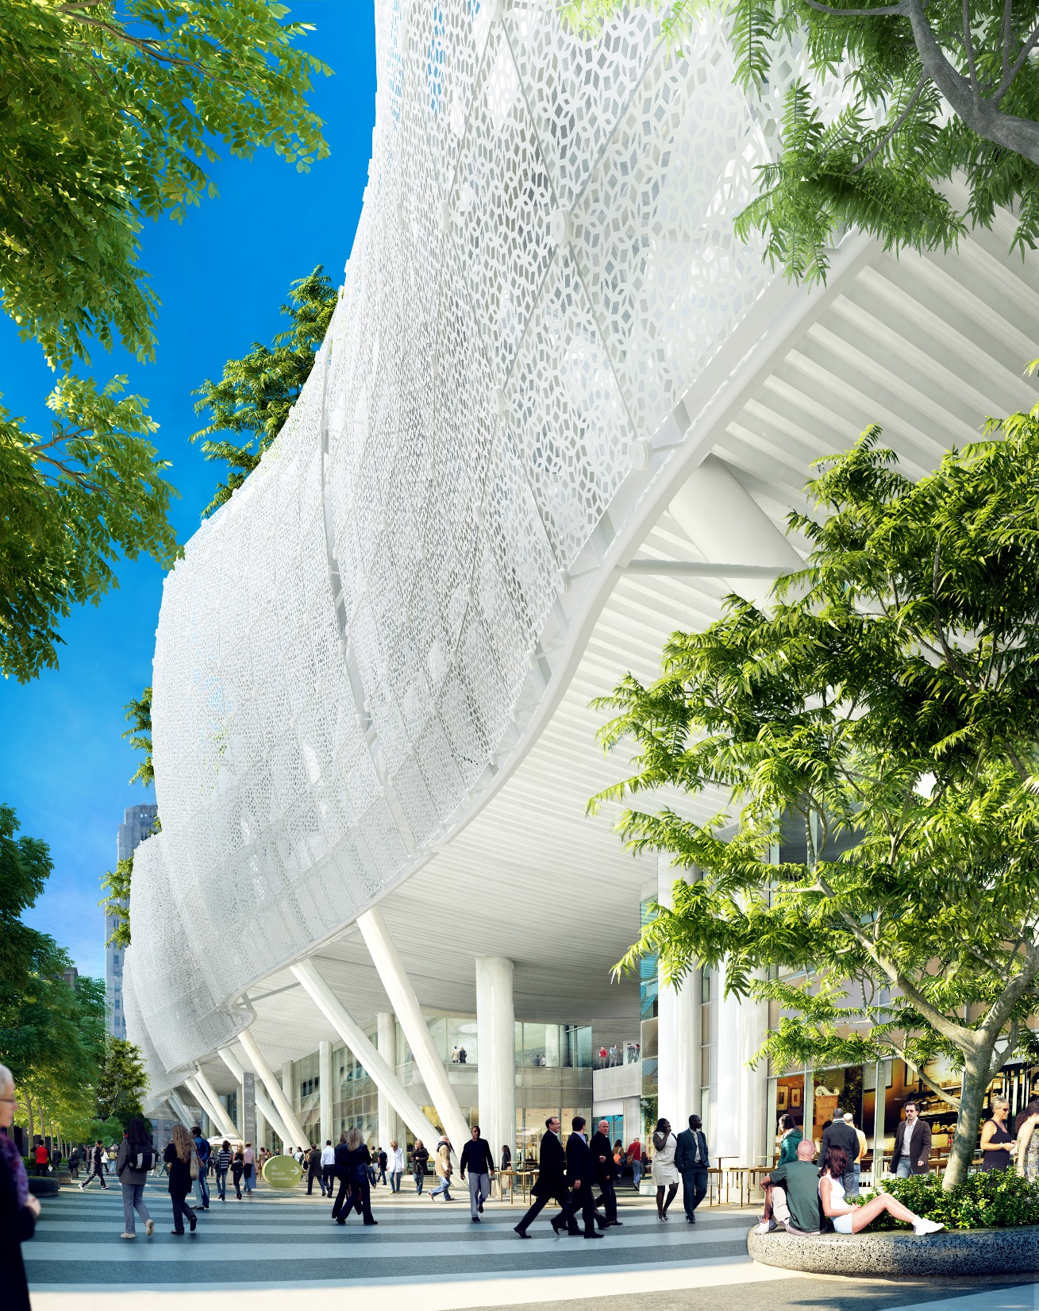
NATOMA STREET VIEW – METAL AWNING
Notes:
Natoma Street is envisioned as a lively pedestrian environment and a significant retail destination for local Bay area food and goods. It remains open and inviting to pedestrians and commuters.

Slide 7
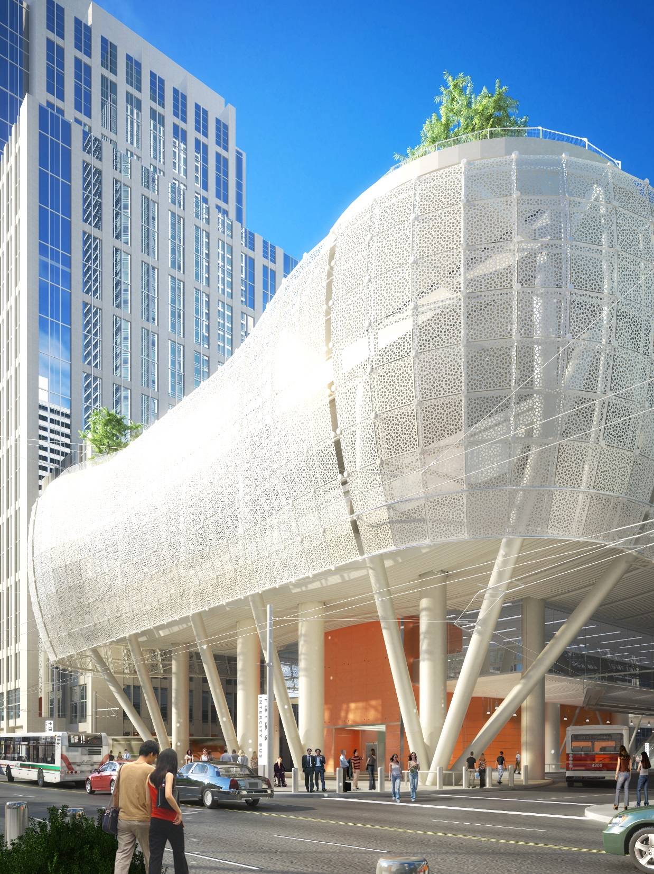
BEALE STREET VIEW
Notes:
With the old bus ramps removed, Beale Street become a significant address for the Transit Center. The building presents an iconic form on Beale, providing a dramatic entrance for bus and train services as well as for retail and the Park.

Slide 8
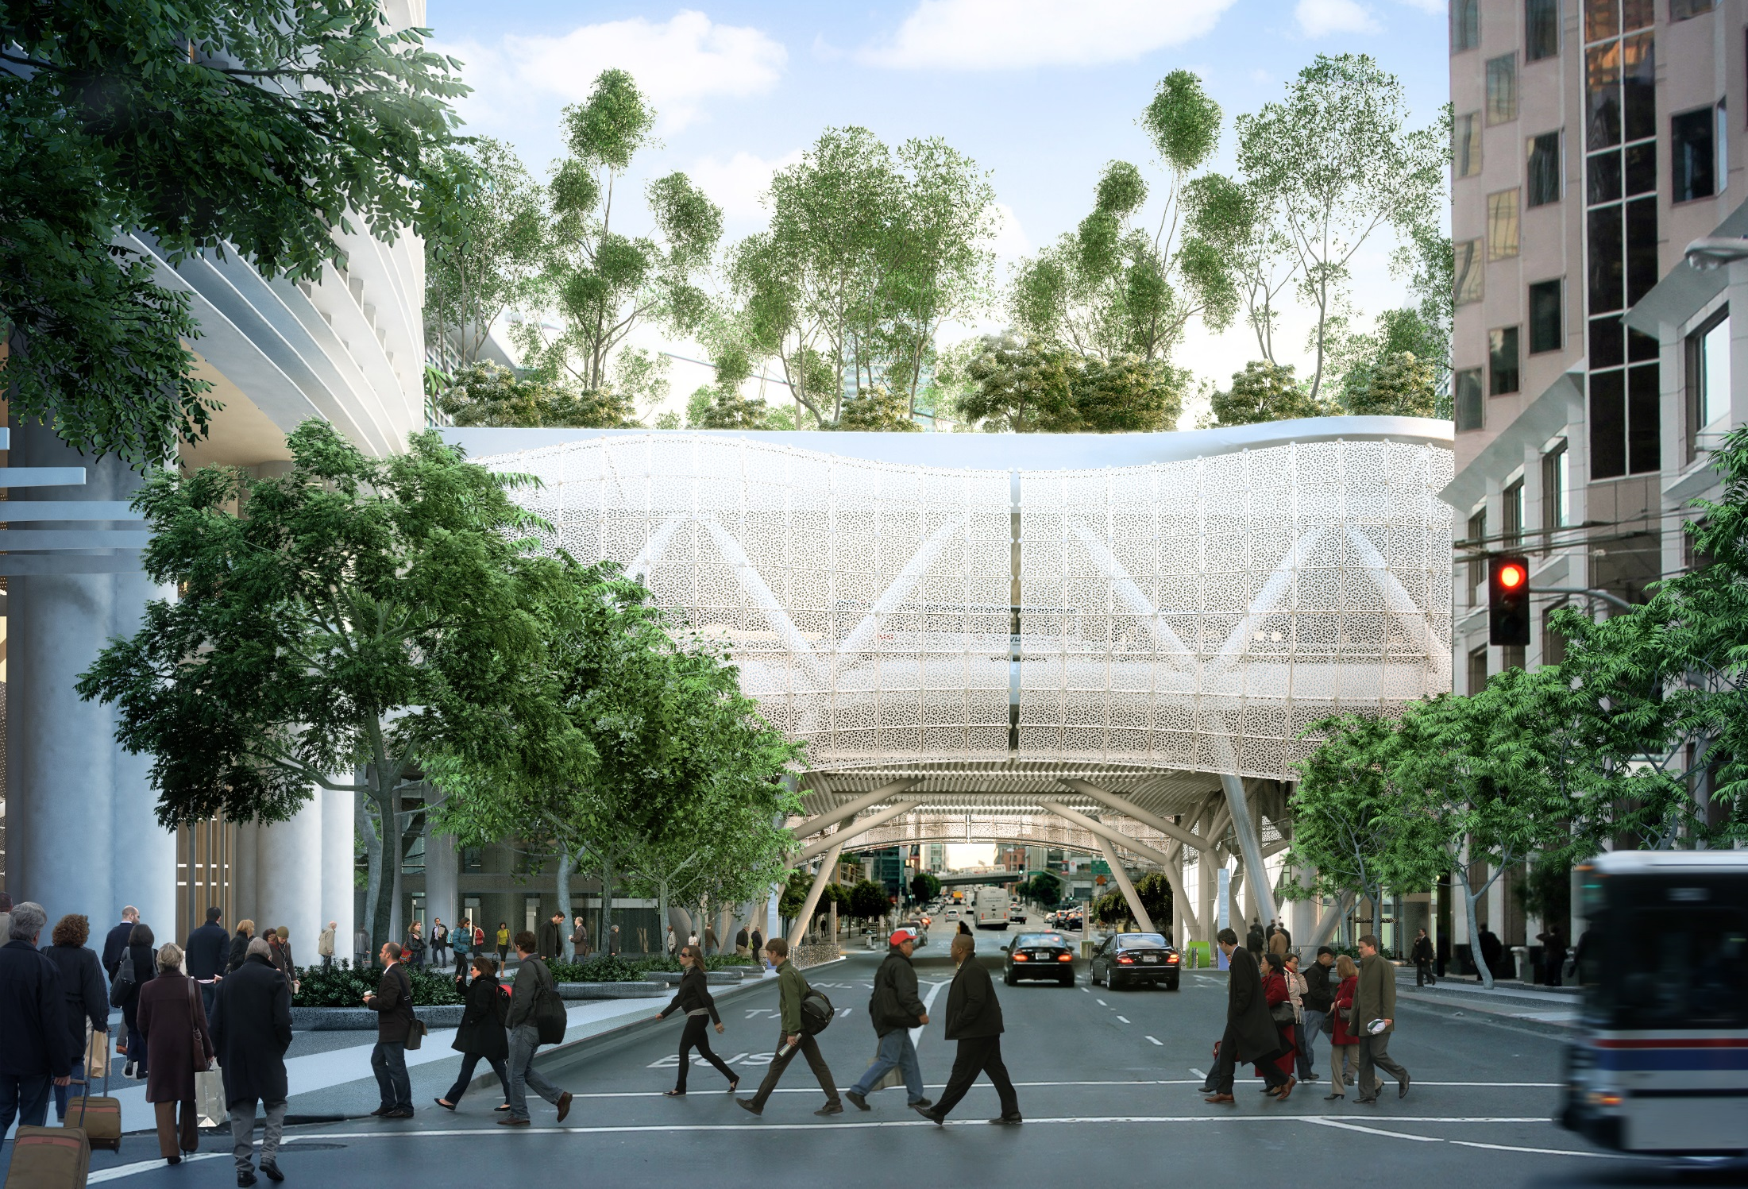
FIRST STREET VIEW
Notes:
Two high-volume streets, Fremont and First, pass under the Transit Center. Passages are spacious and light-filled. Views to and from the Transit Center help ensure that the underpasses are safe. Trees and activity in the Park will also be visible from the street.

Slide 9
MISSION STREET
555 MISSION STREET PLAZA
SHAW ALLEY
MISSION SQUARE
MINNA STREET
GRAND HALL
SHAW ALLEY
NATOMA PEDESTRIAN WAY
NATOMA STREET
FIRST STREET
FREMONT STREET
BEALE STREET
HOWARD STREET
Total Building Area: Over 1 million SF
Total Retail Area: Over 100,000 SF
GROUND LEVEL PLAN
Notes:
The Transit Center will have multiple entrances, but the primary point of arrival will be the Grand Hall. To the east, the Bus Plaza will be the point of arrival and departure for Muni and Golden Gate Transit buses. Beale Street will also be an important entrance. To the west, Shaw Alley and 555 Mission Street Plaza will provide other arrival points into the Transit Center flowing past a concentration of retail spaces that will serve the patrons and the neighborhood.

Slide 10
Amtrak/Greyhound
Office
Retail
Second Level
SECOND LEVEL PLAN
Notes:
The curb side drop offs will be on Natoma Street south of the Grand Hall and on Minna Street. The bus drop off will be on Mission Street in front of Mission Square and boarding will occur at the Bus Plaza. Natoma Street east of Second Street will become a dedicated Pedestrian Way.
The Second Level is programmed as a commercial space retail and office tenants.

Slide 11
Bus Deck
Superintendent Station
GREYHOUND
GREYHOUND
AC TRANSIT
AC TRANSIT
AC TRANSIT
AC TRANSIT
AC TRANSIT
AC TRANSIT
AC TRANSIT
AC TRANSIT
AC TRANSIT
AC TRANSIT
WESTCAT
AC TRANSIT
AC TRANSIT
AC TRANSIT
Bus Waiting Area
AMTRAK
AC TRANSIT
AC TRANSIT
AC TRANSIT
AC TRANSIT
AC TRANSIT
AC TRANSIT
AC TRANSIT
AC TRANSIT
MUNI
MUNI
AC TRANSIT
AC TRANSIT
37 Bus Bays
Bus Ramp
BUS DECK LEVEL PLAN
Notes:
The Bus Deck Level provides 37 bus bays for use by as many as five bus operators. Its straightforward, linear organization promotes a clear and intuitive flow of passengers to and from buses.

Slide 12
Restaurant
Picnic Meadow
Arrival Grove
Bus Fountain
Ground Cover Mound
Main Plaza
Ground Cover Mound
Cafe
West Skylight
Light Column Skylight
East Skylight
Amphitheater
Children’s Play Area
ROOF PARK LEVEL PLAN
Notes:
The 5.4-acre rooftop park will have over a dozen smaller gardens keyed to a variety of natural environments. Active and passive uses are woven into the natural landscape, with features ranging from a music amphitheater for up to 1,000 people, restaurant, café, and a children’s playground. One of the Park’s central feature will be a 1,000-foot-long fountain with jets of water triggered by the movement of the buses arriving and departing below.

Slide 13
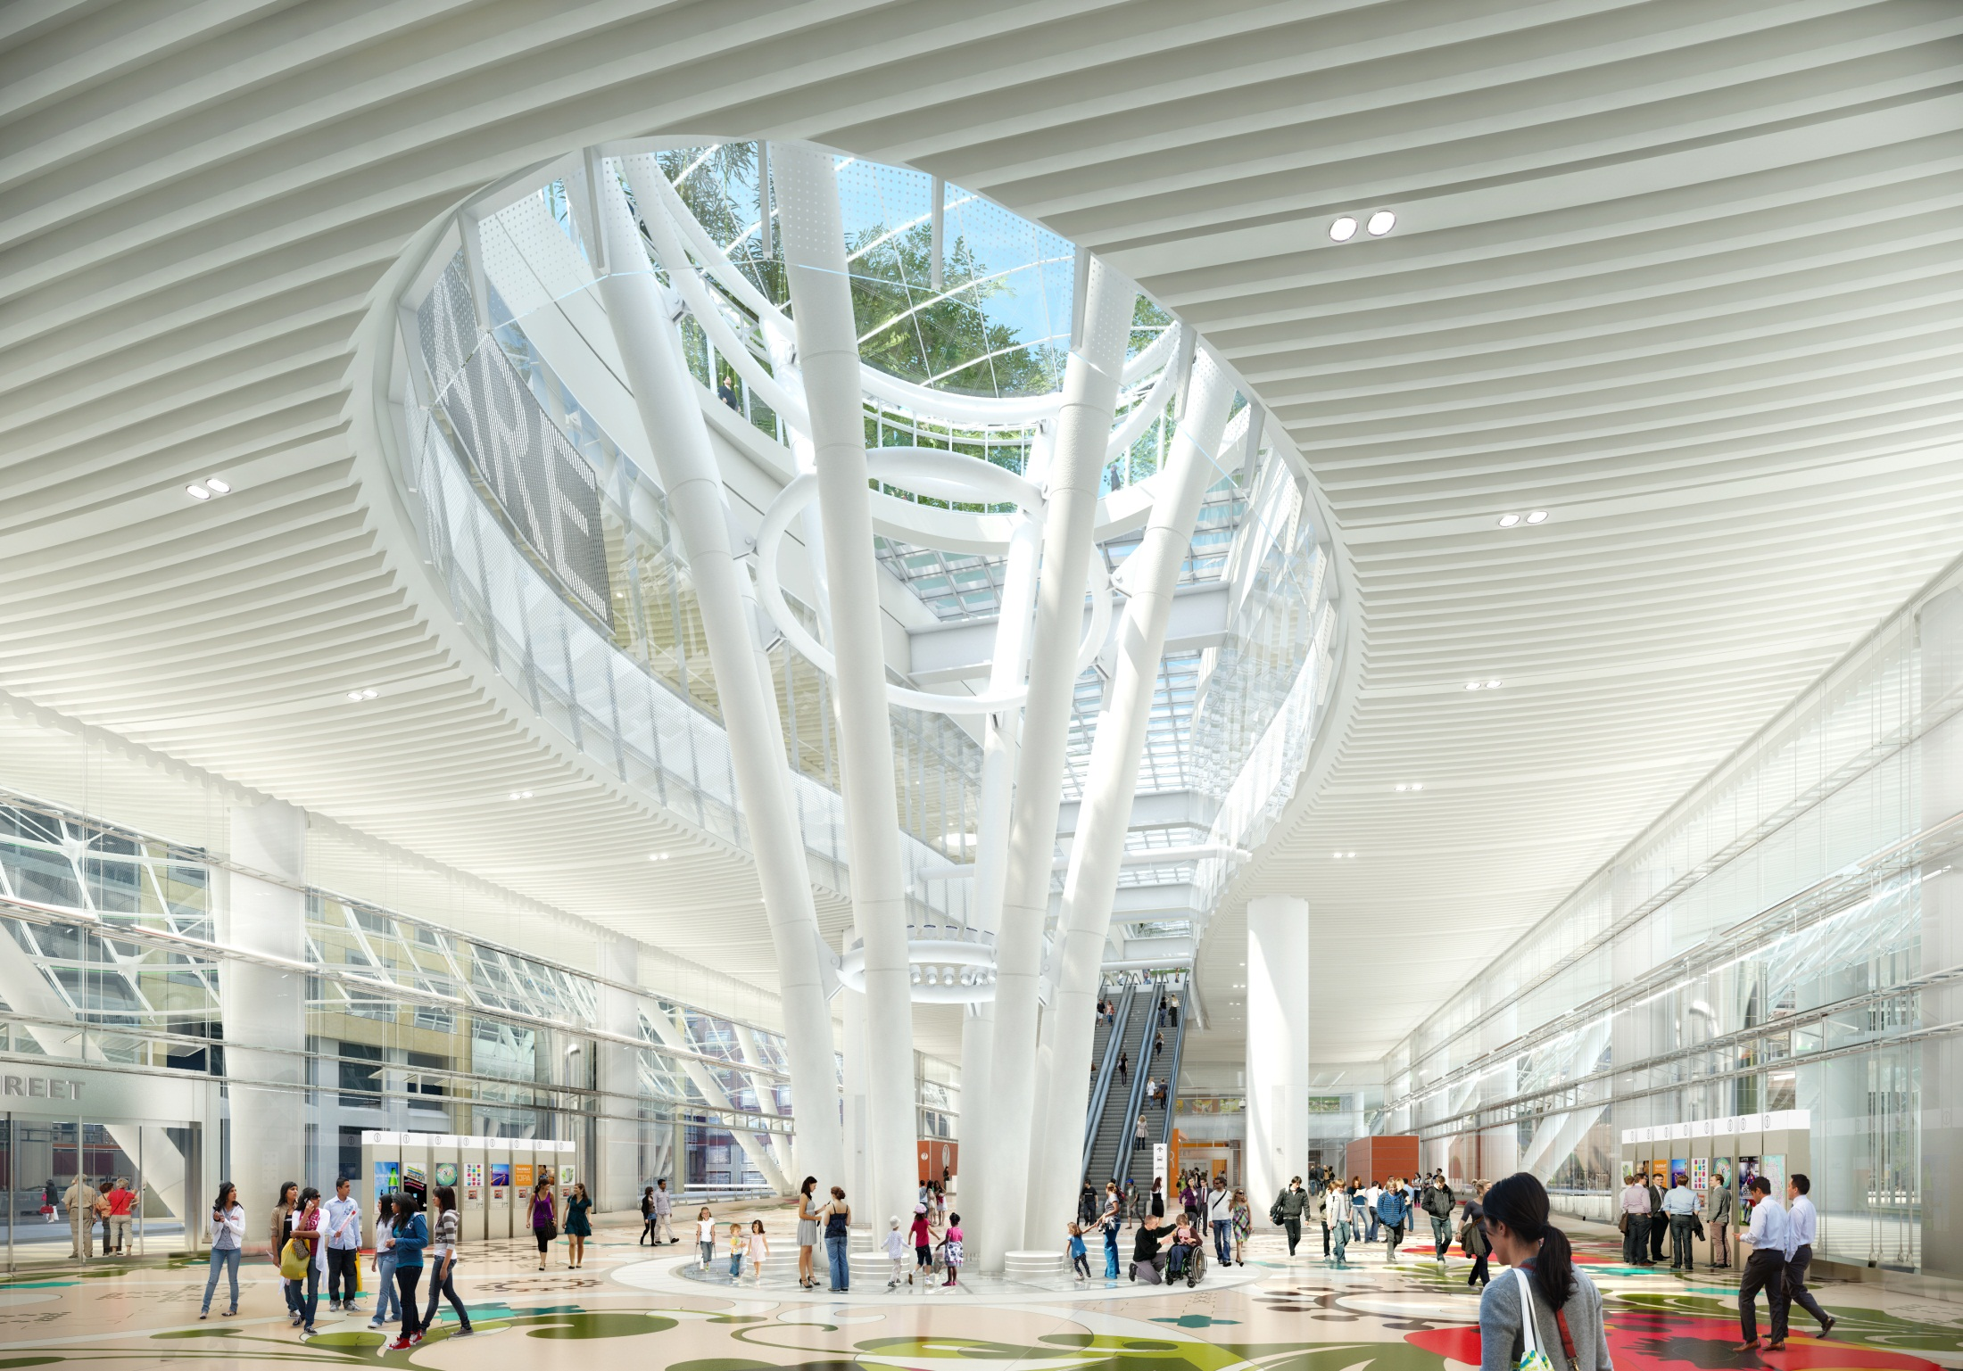
GRAND HALL
Notes:
The Grand Hall is suffused with daylight and luminous colors. In the center of the Grand Hall is the Light Column. Reaching from the Lower Concourse up to the Park, it is topped with an expansive domed skylight. This structural element brings natural light deep into the interior. Escalators and elevators up to the Bus level and Park or down to the Lower Concourse are easily visible.

Slide 14
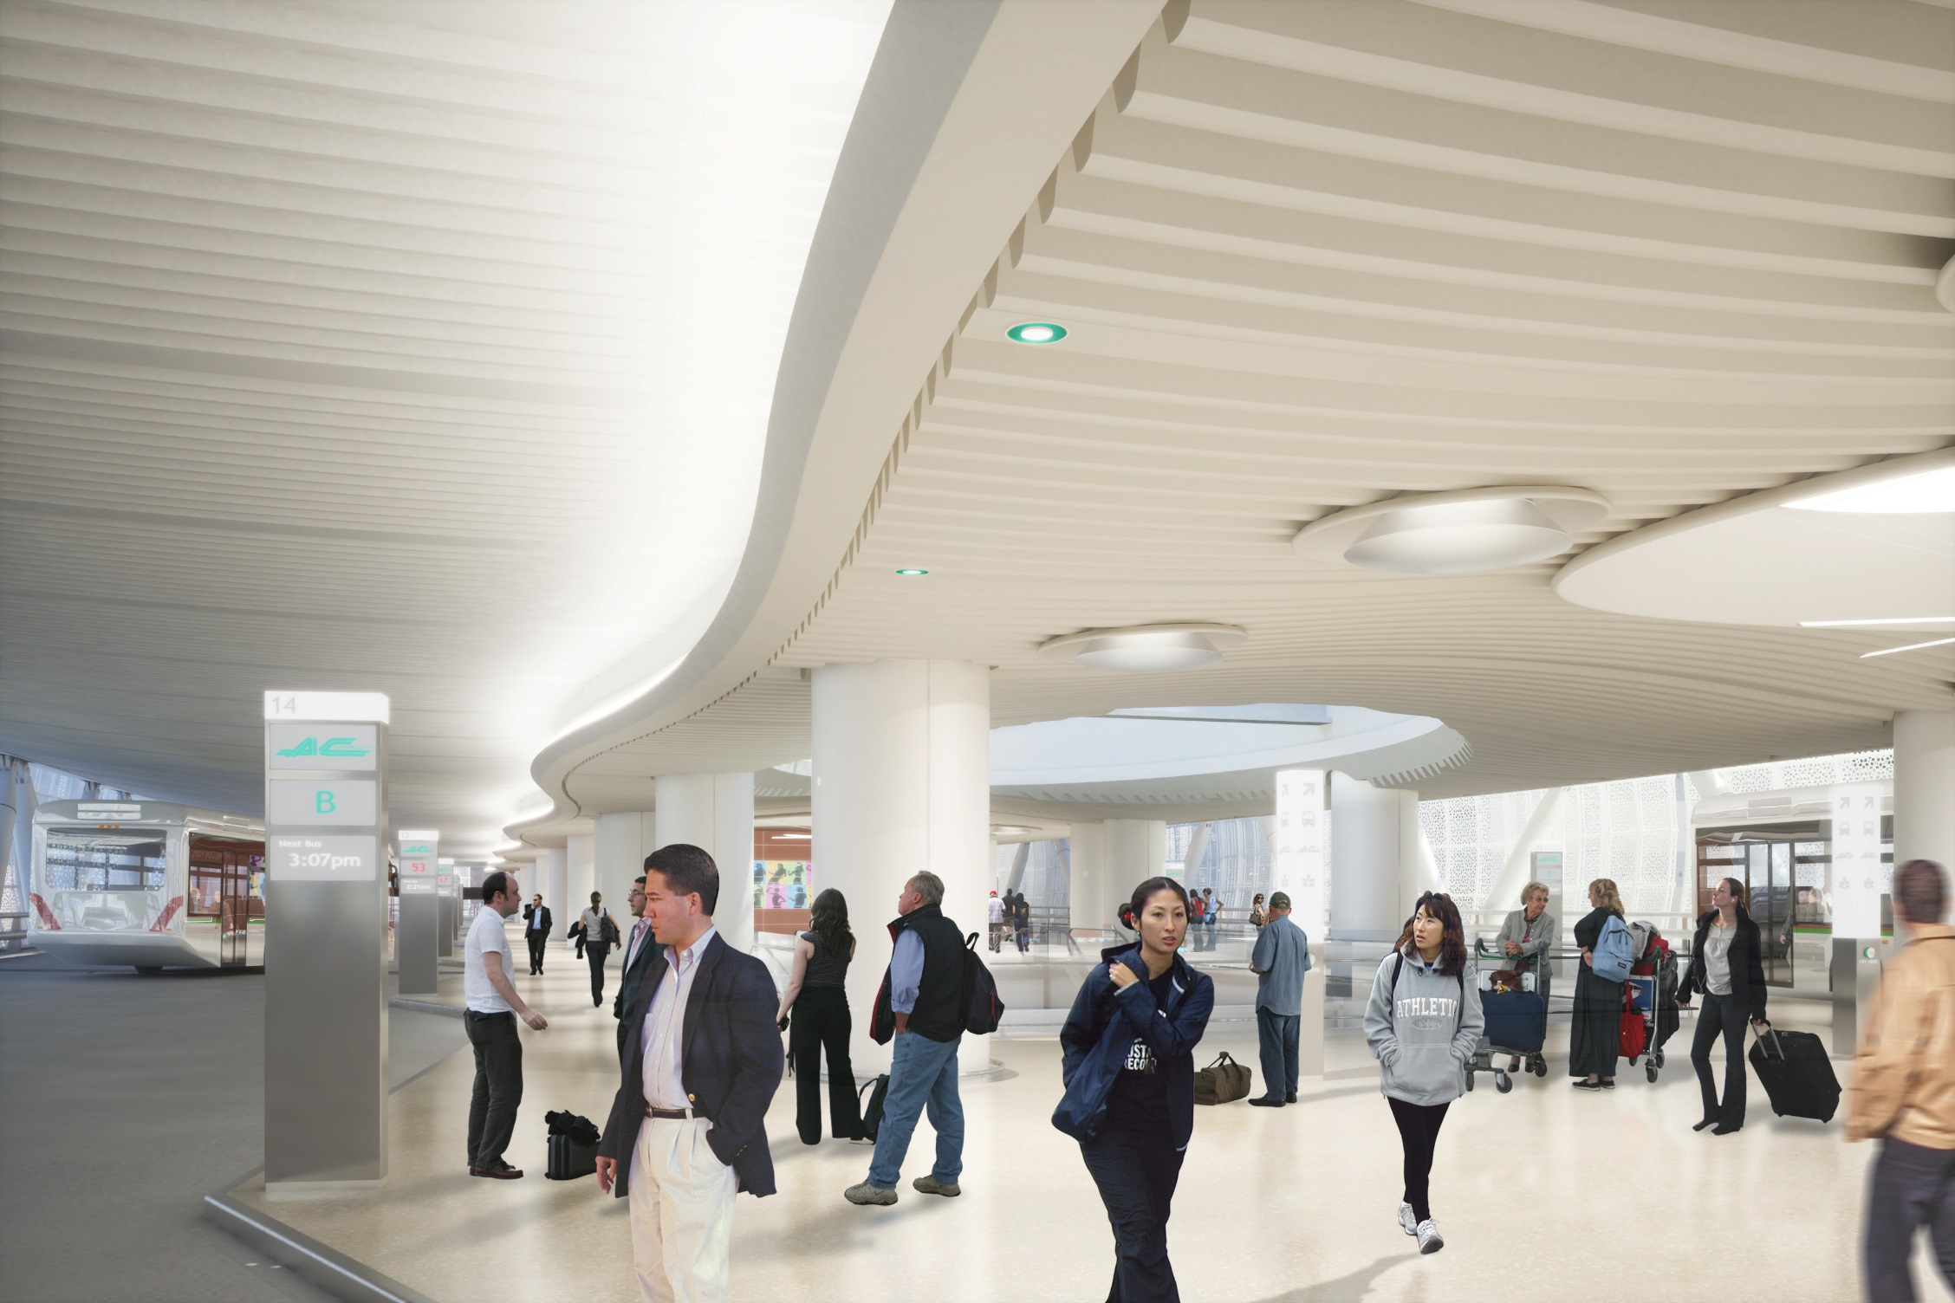
BUS DECK
Notes:
The Bus Level, like the entire Transit Center, is very accessible to all users. The paths to and from buses are clear and straightforward. The Bus Level runs the length of the building with a total of 37 bus bays. Like the rest of the building, the Bus Level will be naturally lit. Visible in the ceiling are points of daylight brought in from the Park through light tubes.

Slide 15
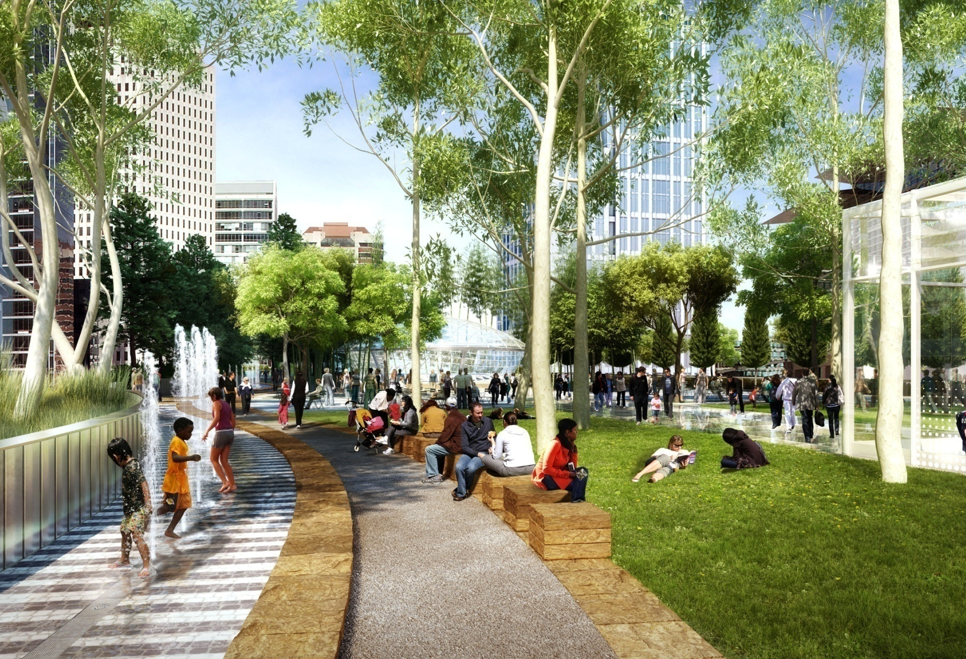
ROOF PARK
Notes:
Visitors arriving to the park are greeted by a beautiful grove of trees, lawns and a fountain. There are views of San Francisco Bay to the east and the Financial District to the north and west. A new residential and mixed-use neighborhood to the south will bring additional visitors to the park.

Slide 16
TRANBAY TRANSIT CENTER
Notes:
At night, the Transit Center’s structural trusses will be illuminated through the elegant exterior veil.

Slide 17
Transbay Transit Center TG16.1 Drywall/Framing
Scope Summary Review
All structural and non-structural metal framing except as specifically excluded.
All support, bracing, embeds, strapping, miscellaneous metal, inserts, block-outs, sleeving, backing, plywood sheathing, blocking, and fish plates associated with/integral to the work of TG16.1.
All ballistic resistant panels integral to and associated with the work of this trade package (see wall types on A-0023).
All seismic/expansion joint assemblies integral to the work of this trade package (framed walls, ceilings, cement plaster, etc.).

Slide 18
Transbay Transit Center TG16.1 Drywall/Framing
Scope Summary Review
All joint sealants associated with/integral to this scope of work.
All access doors as indicated within the Contract Documents.
All cement plaster, including associated support, accessories, flashing, and all other elements integral to the system.
All gypsum wall and cement backer board except as specifically excluded.
All acoustic ceiling tile systems.

Slide 19
Transbay Transit Center TG16.1 Drywall/Framing
Scope Summary Review
All access flooring systems and associated floor finish/floor coverings.
All fire extinguishers, fire extinguisher cabinets, brackets, and any other mounting assembly required (see response to RFI P1-0422).
All toilet accessories and metal lockers.
All bird control devices/bird deterrent systems except as specifically excluded.
All scaffolding for own work.

Slide 20
Transbay Transit Center TG16.1 Drywall/Framing
Scope Summary Review
All scanning required for this scope of work (see S-0005 for examples of post installed anchor requirements)
All engineering for the work of this trade package
All acoustic insulation and sealants except as specifically excluded.
All toilet partitions and screens. All partition hangers, supports, bracing and connections to structure are to be included in this scope of work.
All acoustical wall treatments.

Slide 21
Transbay Transit Center TG16.1 Drywall/Framing
Scope Summary Review
All sheet metal flashing and trim integral to this scope of work (UV Flashing, flashing of penetrations, fire rated assemblies, etc.).
All thermal and safing building insulation (sprayed insulation, batt insulation, rigid insulation, air sealing, head of wall, edge of deck, CMU/Concrete expansion joints, etc.) except as specifically excluded.
All penetration firestopping except as specifically excluded.
All operable partitions

Slide 22
Transbay Transit Center TG16.1 Drywall/Framing
Scope Summary Review
Fireproofing may be installed prior to installation of clips. At areas where fireproofing has been installed prior to the work of this trade package, TG16.1 shall scrape all fireproofing for own work, and pay TG16.8 to restore all fireproofing disturbed as a result of own work.
All firestopping and acoustic assemblies associated with all walls and edge of deck assemblies except as specifically excluded.
Design, furnish, install, and remove elevated work platforms and motorized winches for use by all trade subcontractors requiring access.
All Acclimatization for the work of this Trade Package.

Slide 23
Transbay Transit Center TG16.1 Drywall/Framing
Scope Summary Review
Assume a value of 2% of base furnish and installation value to install access doors furnished by MEP trades. Furnish and install added wall/ceiling framing as coordinated with MEPS Trade Subcontractor.
Assume a value of 3% of the base furnish and install value to position and install fire extinguisher cabinets as required by Specification Section 10 44 13 1.3.
Assume a value of 2% of the base furnish and installation value to restore the work of this trade package impacted by other trades protecting their work.
Assume a value of 3% of the base furnish and install value to restore gypsum board damaged after initial installation as directed by Webcor/Obayashi Joint Venture.

Slide 24
Transbay Transit Center TG16.1 Drywall/Framing
Alternate #13: Defer installation of Service Elevator SE201 and provide shaft wall infill at door locations.

Slide 39
Transbay Transit Center TG16.1 Drywall/Framing
Questions?

Slide 40
Transbay Transit Center TG16.1 Drywall/Framing
IFB Package Timeline
Bid Package Issued: | September 9, 2014
Pre-Bid Conference: | October 2, 2014 (2:00 p.m.)
Qualifications Due (for non-prequalified): | October 21, 2014 (2:00 p.m.)
Notification of Qualification (for non-prequalified): | October 28, 2014
Questions/Clarifications (QBD) Due: | October 28, 2014 (2:00 p.m.)
Pre-bid Request for Substitution Due: | October 28, 2014 (2:00 p.m.)
Value Engineering (VE) Proposals Due: | November 4, 2014 (2:00 p.m.)
VE Proposals Review: | November 5 - 17, 2014
Bid Package Due: | November 18, 2014 (2:00 p.m.)
Public Bid Opening: | November 18, 2014 (2:00 p.m.)
Protest Period: | November 18, 2014 (2:00 p.m.) – November 25, 2014 (2:00 p.m.)
Notification of Intention to Award Contract: | December 2014
TJPA Board Vote to Approve the Contract Award: | December 11, 2014

Slide 41
Transbay Transit Center TG16.1 Drywall/Framing
Obtaining Contract Documents
TJPA Website
List of all Exhibits
Non Disclosure Agreement (NDA)
Plan Room (ARC)
Non-SSI
SSI
Box.com
SSI (Managed by TJPA)
Supplemental Documents (Managed by Webcor-Obayashi Joint Venture)

Slide 42
Transbay Transit Center TG16.1 Drywall/Framing
Request for Information
P1-0062 to P1-0133
Pay close attention to the following RFIs:
RFI No. | Subject | RFI No. | Subject
P1-0062 | GFRC Details | P1-0096 | Framing Material
P1-0062.1 | Details for Portland Cement Plaster per RFI Response P1-0062 | P1-0096.1 | Information for Vertical Z Girts
P1-0068 | Insulation at Detail 2/A1-8181 | P1-0097 | Bench Details
P1-0068.1 | Documentation for Concrete Platform at Bus Deck Superintendent Station | P1-0097.1 | Clarification for Choice in Bench Anchors
P1-0084 | Attachment Details for Linear Supply Air Diffuser | P1-0099 | Painted Shaft Wall
P1-0092 | Rated Soffit | P1-0099.1 | Finish Level Clarification for Painted Interior Shaft Walls
P1-0093 | Fire rated assembly | P1-0099.2 | Level 1 Paint Finish Requirements
P1-0094 | Elevator Deferral | P1-0131 | Fire Blankets Shown at Ceiling Locations
P1-0094.1 | Additional Information For Elevator Deferral | P1-0132 | Installation Requirements for Insulation
P1-0095 | Elevator Deferral | P1-0132.1 | Language Revision for Material Installation per Specification Section 09 80 00
P1-0095.1 | Additional Information Elevator Deferral | P1-0133 | Relative Humidity Requirement

Slide 43
Transbay Transit Center TG16.1 Drywall/Framing
Request for Information
P1-0191 to P1-0404
Pay close attention to the following RFIs:
RFI No. | Subject | RFI No. | Subject
P1-0191 | Plywood installation | P1-0394 | Insulation Specification for Parapets
P1-0202 | Call outs Marked "FUTURE" | P1-0395 | Request for Specification Section 07 12 11 Cellular Foamed Glass Insulation
P1-0283 | R1 Requirements for Wall Type 3 | P1-0396 | Request for Specification Section 07 27 00
P1-0344 | Access Opening Details per Detail A/A1-8630A | P1-0397 | Design-Build Requirement for Roof Hatches
P1-0345 | W10X54 Beam Connections to Adjacent Concrete Walls and Piers | P1-0398 | Tubular H.O.G. Protective Enclosure and Stainless Steel Surface Collar Details
P1-0388 | Metal Framing Design-Build Compliance with Specification Section 08 05 13 | P1-0399 | Revision of Referenced Specificaton Section 09 90 00
P1-0389 | CJC4 Expansion Joint at Second Level GL 10 | P1-0400 | Portable Lighting Requirement per Specification Section 09 21 16 1.6 E
P1-0390 | WJC4 Adjoining Materials | P1-0401 | Utilization of Level 4 Finish
P1-0391 | Insulated Soffit References per A1-9603 | P1-0402 | Revision of Referenced Specificaton Section 09 31 00
P1-0392 | Ceiling Type for Room 01603 | P1-0403 | Acclimization Requirements for ACT Installation
P1-0393 | Insulation Beneath the Radiant Floor Heating System | P1-0404 | Clarification for Work Supported from ACT System

Slide 44
Transbay Transit Center TG16.1 Drywall/Framing
Request for Information
P1-0405 to P1-0431
Pay close attention to the following RFIs:
RFI No. | Subject | RFI No. | Subject
P1-0405 | Acclimization Requirements for Access Flooring | P1-0419 | Application of Specification Section 01 80 50
P1-0406 | Correction of Fahrenheit to Celsius Calculation | P1-0420 | Framing Details for Access Panels Within Gypsum Board Ceilings
P1-0407 | Information on Fire Extinguisher Cabinets | P1-0422 | Fire Extinguisher Locations per Specification Section 10 44 13 1.3 C 2 c
P1-0408 | Interior Bird Deterrent Systems Specifications | P1-0424 | Installation of Electrical Components per Specification Section 09 24 00 1.1 C 2
P1-0409 | Drill Holes for the Birdwire System | P1-0425 | Test Methods per Specification Section 09 24 00 1.7 G 2
P1-0410 | Painting of ACT-1 Ceiling for B1268 | P1-0426 | Confirm the Use of Scanning and Other Means to Locate Reinforcing Bars
P1-0411 | ACT Ceiling Type for Room 01223 | P1-0427 | Drawings for Portland Cement Plaster
P1-0412 | AWP-1 Call Out per Specification Section 09 77 23 | P1-0428 | Portland Cement Plaster Color
P1-0413 | Wall Protection Systems Locations per Specification Section 10 26 00 | P1-0430 | Wall Type Clarification at Stair 601A
P1-0414 | Structural Information for HSS Post and Column Baseplate | P1-0431 | Locations Where Wall Type 30 and 61 Support W-5 System

Slide 45
Transbay Transit Center TG16.1 Drywall/Framing
Redline Markups
The redline marked up drawings and narratives included with the ASI documents are designed to relay specific scopes of work that are modified to reflect scope changes. Redline markups in ASI drawings are only to be used to indicate scope modifications. These scope modifications are to be applied to the current set of drawings and specifications.

Slide 46
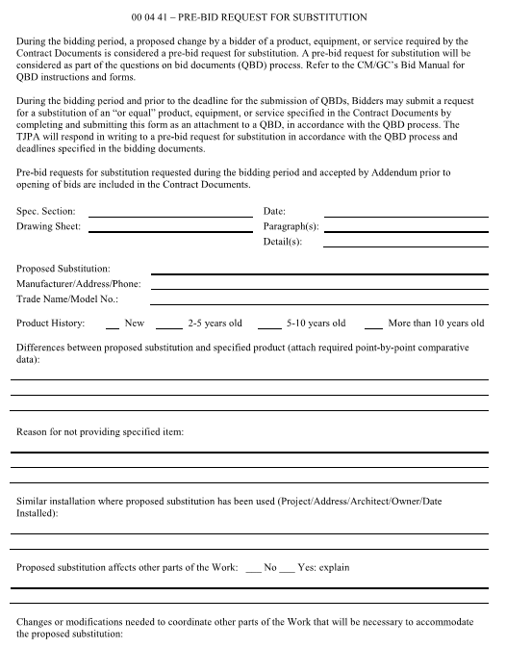
Transbay Transit Center TG16.1 Drywall/Framing
Pre-Bid Substitution Request

Slide 47
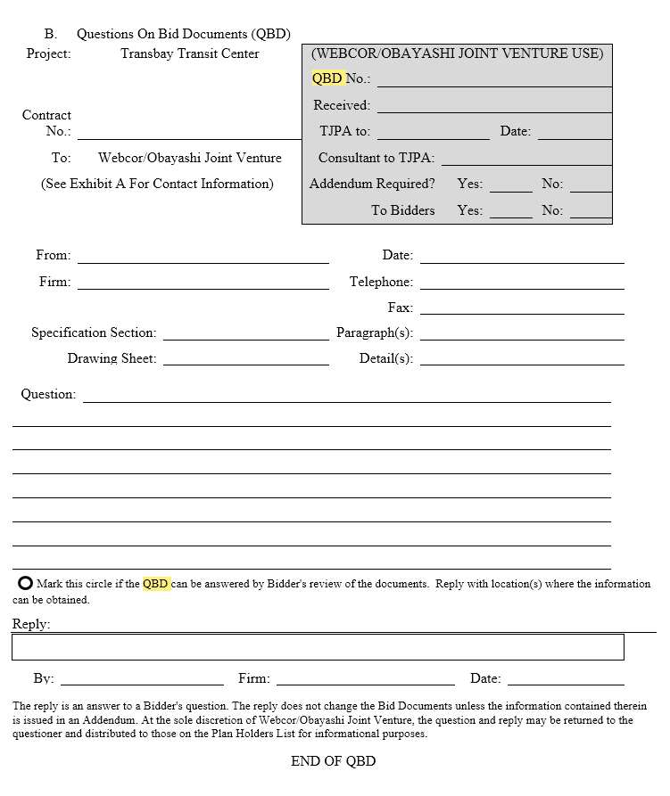
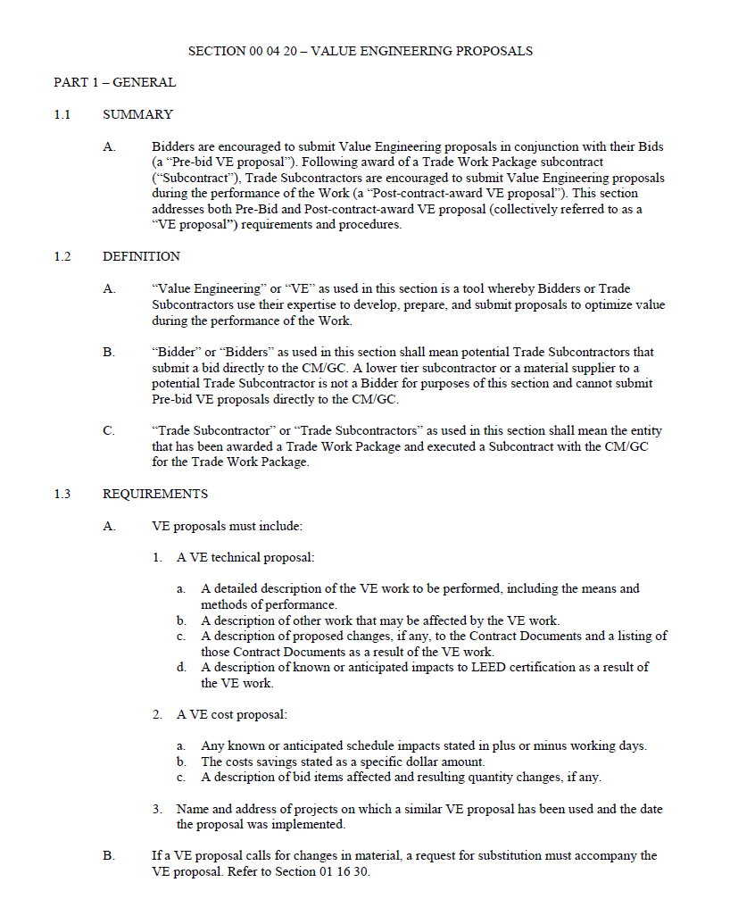
Transbay Transit Center TG16.1 Drywall/Framing
QBD & VE Process

Slide 48
Transbay Transit Center TG16.1 Drywall/Framing
Webcor and Subguard Prequalification Process
Step 1:
Email:
Mary Hobbs, Estimating mhobbs@Webcor.com
Tim Lutz, CFO Tim@Webcor.com
Subject line: Transbay TG16.1
Full name of Contact
Title of Contact
E-mail of Contact
Full legal company name
Mailing address
Phone number
Fax number
Contractor’s license number
Federal I.D. No
Scope of work
Financials over last 2 years (audited or review)
Email or Mail
Tim Lutz, CFO
175 Harbor Bay Parkway, Suite 200
Alameda, CA 94502
Step 2:
Mary Hobbs will send you an email with a link to the Webcor Builders prequalification system
Click the link and upload the required information
Once you are finished click the submit button
Step 3:
Financials and Qualifications will be evaluated by WOJV

Slide 49
Transbay Transit Center TG16.1 Drywall/Framing
Questions?

Slide 50
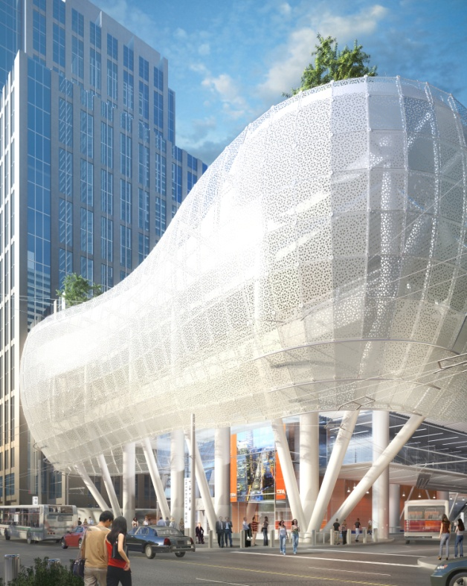
Transbay Transit Center TG16.1 Drywall/Framing
SBE Program Overview/Participation Goal
Notes:
Welcome!

Slide 51
Transbay Transit Center TG16.1 Drywall/Framing
SBE PROGRAM OVERVIEW
Certification & Certifying Agencies
DBE
SBE
LBE

Slide 52
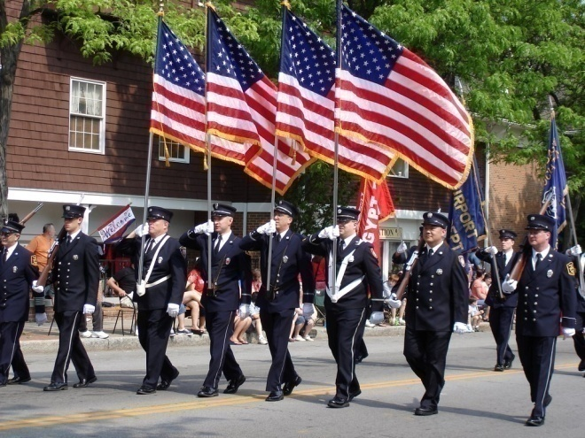
Transbay Transit Center TG16.1 Drywall/Framing
Veteran Business & Workforce Participation

Slide 53
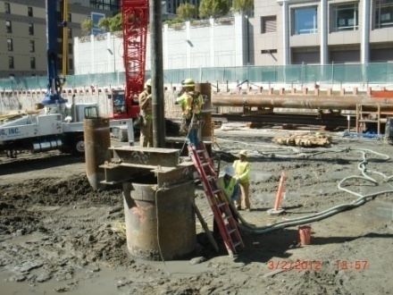
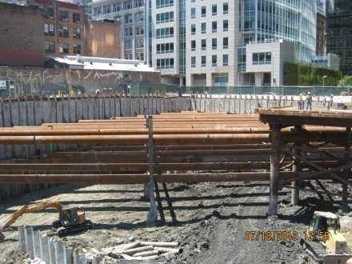
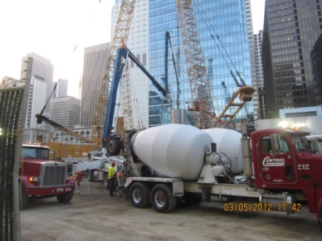
Transbay Transit Center TG16.1 Drywall/Framing
Overall SBE Project Participation Goal: 17%
143 SBEs to date
17%

Slide 54
Transbay Transit Center TG16.1 Drywall/Framing
Participation Goal
20%
20% SBE Participation Goal for this Package
Focus on “Trade Package Specific Information”
Certifications: SBE/DBE/LBE
Certification: Assistance Provided By Program
Compliance: Commercially Useful Function Guidelines

Slide 55
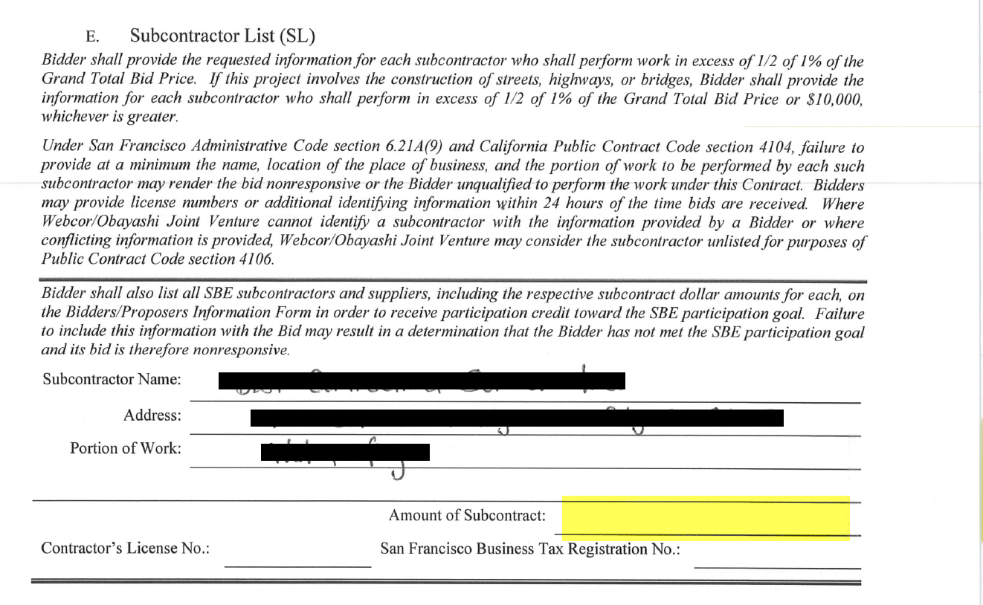
Transbay Transit Center TG16.1 Drywall/Framing
E. Subcontractor List (SL) – Project Bidding Manual
5%

Slide 56
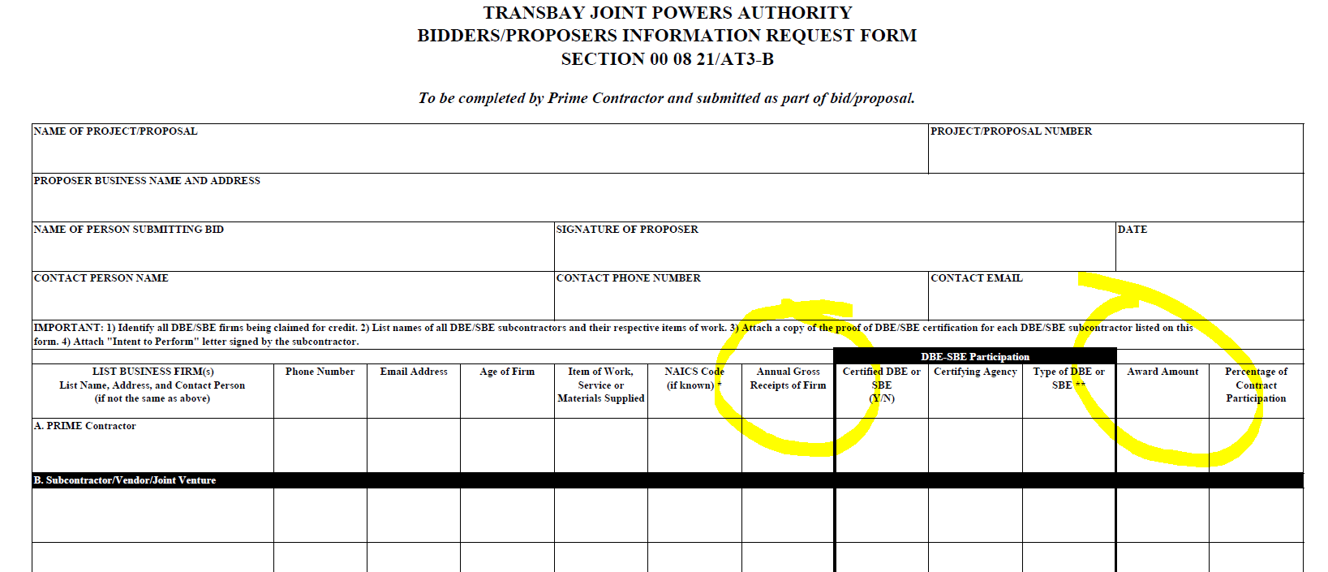
Transbay Transit Center TG16.1 Drywall/Framing
Bidder/Proposer Information Request From 00 08 21/AT3-B
5%

Slide 57
Transbay Transit Center TG16.1 Drywall/Framing
Remember to sign all forms!!
Questions?
Thank You!

